Slide 1
BOSCH AutoVision X Hackathon SVS – Surround View System
CHALLENGE: Image Stitching Application Using C++
Team 1Neuron – Akash Rai, Ankur
- 11th February 2024

Slide 2
Table of contents
1.
3.
Tools Required
Introduction
2.
Objectives
4.
Methodology
5.
Output

Slide 3
Introduction
The Surround View System is a C++-based application that allows for the seamless stitching of an arbitrary number of photos captured from various devices. C++ was chosen as the major programming language because of its better execution speed, which is especially important for real-time applications like autonomous vehicles, where quick inference times are required to avoid negative repercussions.
This application takes advantage of CPUs' parallel processing capabilities and, when available, GPUs. Notably, the system accepts both sequential and non-sequential image inputs and prioritizes matches within the images. Furthermore, the application is designed to work easily on x64 platforms using the MinGW compiler, assuring compatibility without requiring additional dependencies from end users like building OpenCV and related dependencies only by using the executable file.

Slide 4
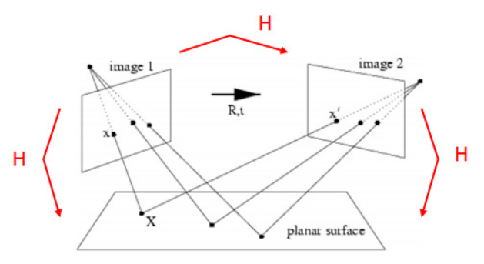
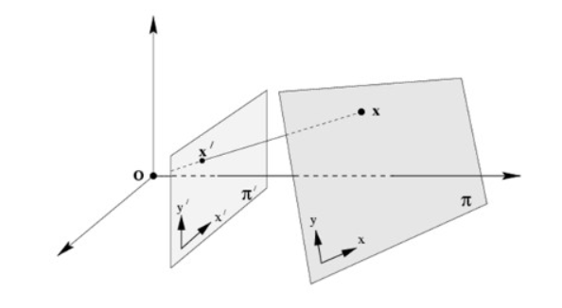
Introduction

Slide 5
Table of contents
1.
3.
Tools Required
Introduction
2.
Objectives
4.
Methodology
5.
Output

Slide 6
Objectives
Image inpainting
Parallel Computation
Memory Optimization
Static Linking.

Slide 7
Table of contents
1.
3.
Tools Required
Introduction
2.
Objectives
4.
Methodology
5.
Output

Slide 8
Tools Required
CMake
Visual Studio
OpenCV
GUI

Slide 9
Table of contents
1.
3.
Tools Required
Introduction
2.
Objectives
4.
Methodology
5.
Output

Slide 10
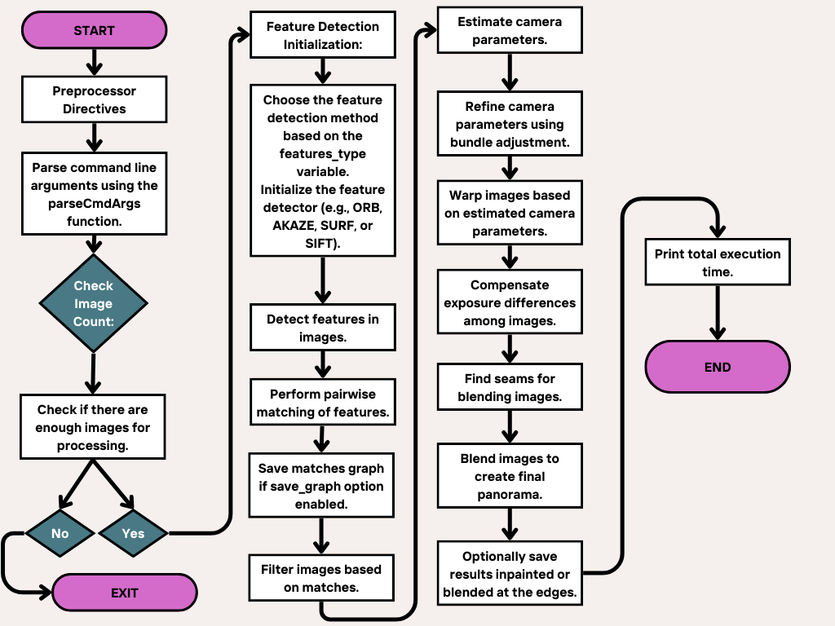
Methodology

Slide 11
Table of contents
1.
3.
Tools Required
Introduction
2.
Objectives
4.
Methodology
5.
Output

Slide 12
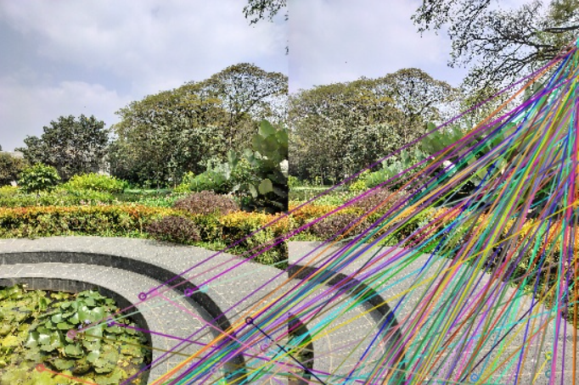
Output

Slide 13
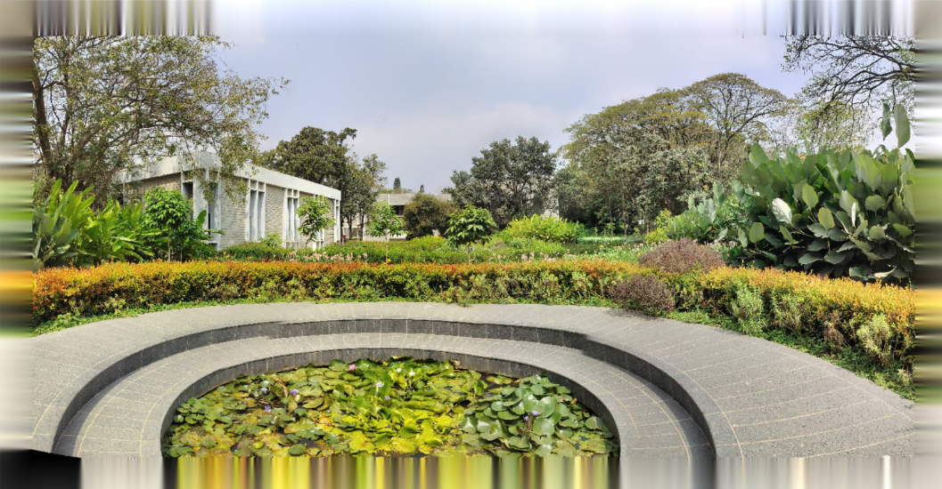
Output

Slide 14
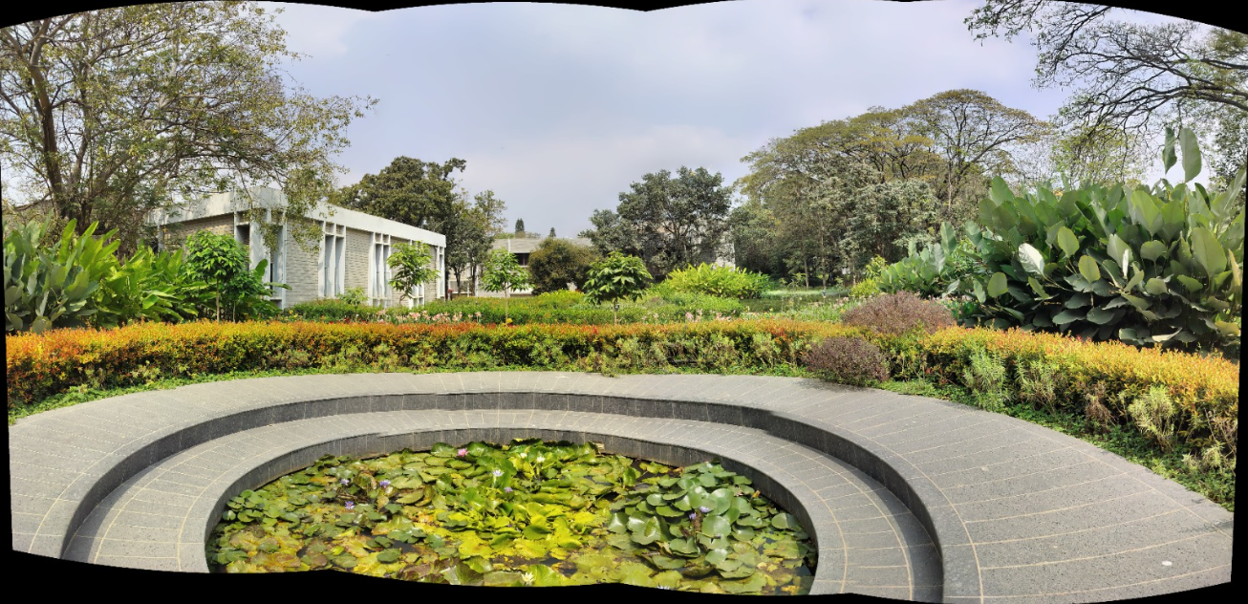
Output

Slide 15
Output

Slide 16
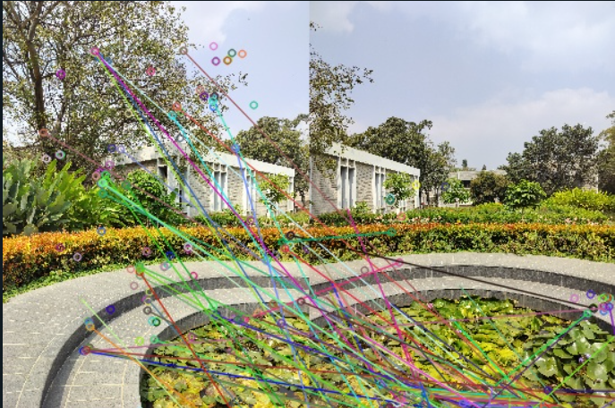
Output

Slide 17
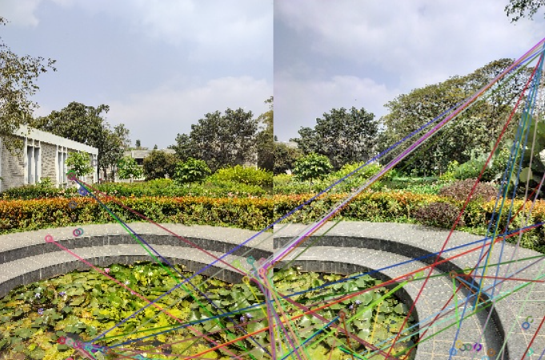
Output

Slide 18
Thank
YOU

